Slide 1
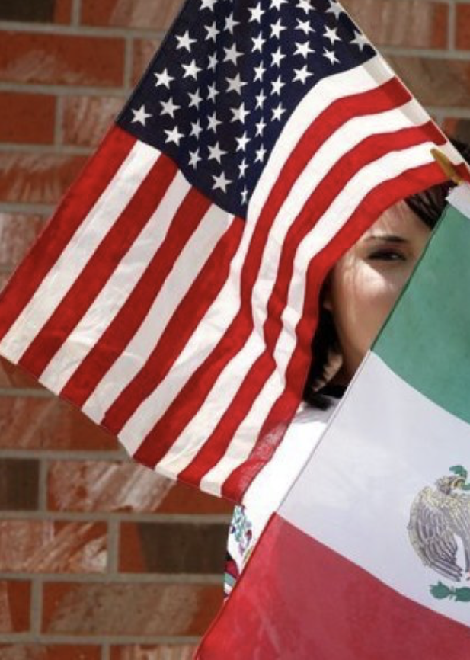
Give Me Your Poor, Your Tired, Your Homeless (Some Restrictions
May Apply):
Immigration to the United States in the 21st Century
Bob Gitter, Ohio Wesleyan
Prof of Econ, Emeritus
National Economic Education Delegation
University of Minnesota OLLI
June 27, 2024

Slide 2
Submitting Questions
We will do a Q&A after the presentation
I can stay after if some of you have additional questions.

Slide 3
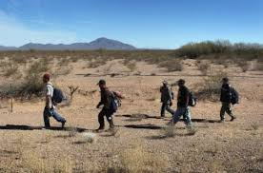
Migration to the US
Difficult to Measure How Many
Legal Immigrants - easy
Undocumented Immigrants
Return Immigrants – no record if return

Slide 4
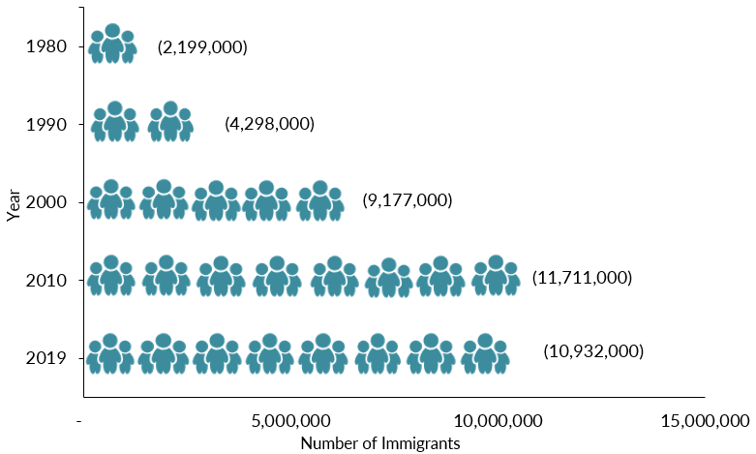
Mexican-Born People in the US
1 in 14 people born in Mexico currently lives in the US

Slide 5
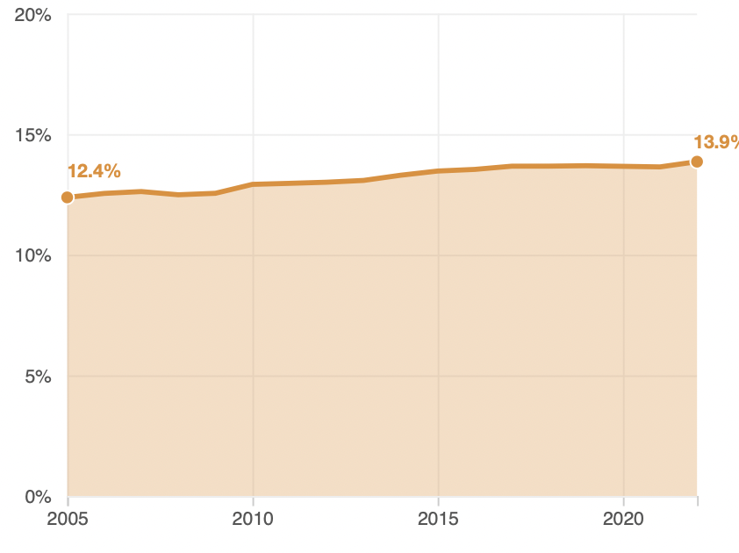
Immigrant Share of US Population
13.9 %
12.4 %

Slide 6
Immigrant Share of US Population
Minnesota 8.4 %
Twin Cities 12.0%
12.4 %
13.9 %

Slide 7
The Migration Decision
Benefit of Migrating
Benefit of Staying
Cost of Migrating

Slide 8
Distribution of Income
Share of
Population
Mexico
United States
Low Level of Income High

Slide 9
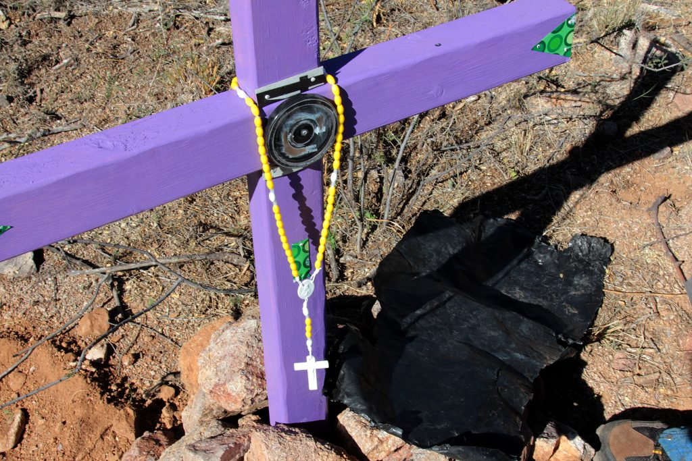
The Dangers of Border Crossing

Slide 10
Key Laws
Quota and Immigrations Acts (1921 and 1924)
Bracero Program (1942-1964)
Immigration and Nationality Act (1965)
Immigration and Control Act (1986)

Slide 11
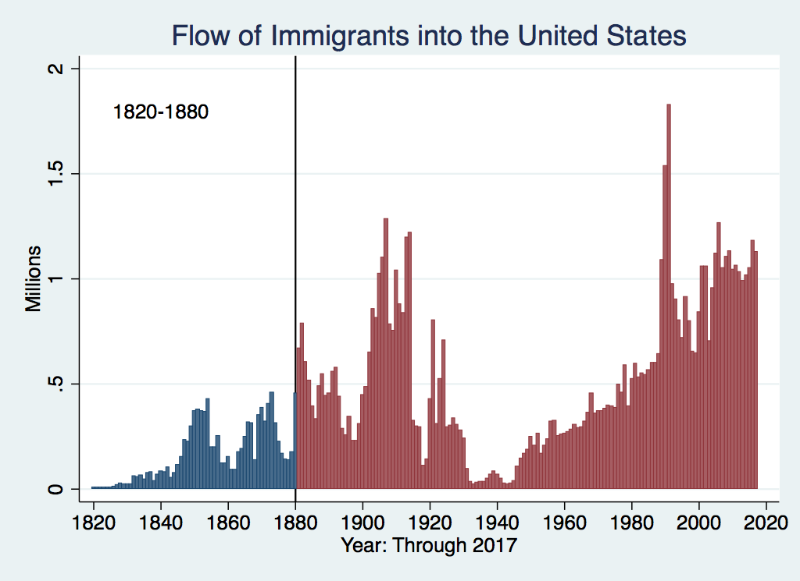
U.S. Immigration 1820-1880
Source Country | 1820-1880
Germany | 3,000,000
Ireland | 2,800,000
Britain | 2,000,000
Austro-Hungarian Empire | 1,000,000
Canada | 750,000
China | 230,000
Africa | 50,000
https://www.libertyellisfoundation.org/immigration-timeline

Slide 12
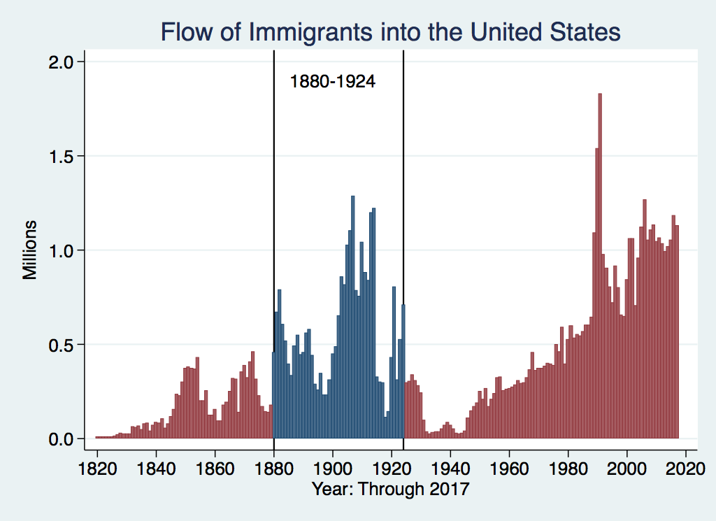
U.S. Immigration 1880-1924
Source Country | 1880-1930
Italy | 4,600,000
Austro-Hungarian Empire | 4,000,000
Russian Empire | 3,300,000
German Empire | 2,800,000
Britain | 2,300,000
Canada | 2,300,000
Ireland | 1,700,000

Slide 13
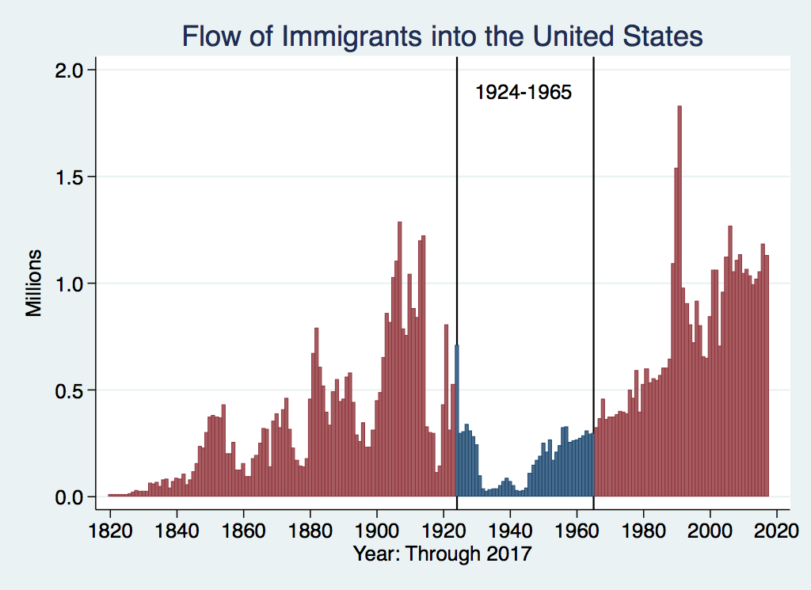
U.S. Immigration 1924-1965
Source Country | 1930-1965
Germany | 940,000
Canada | 900,000
Mexico | 610,000
Britain | 480,000
Italy | 390,000
Caribbean/ West Indies | 310,000
https://www.libertyellisfoundation.org/immigration-timeline

Slide 14
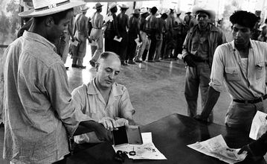
Signing up for Bracero Program

Slide 15
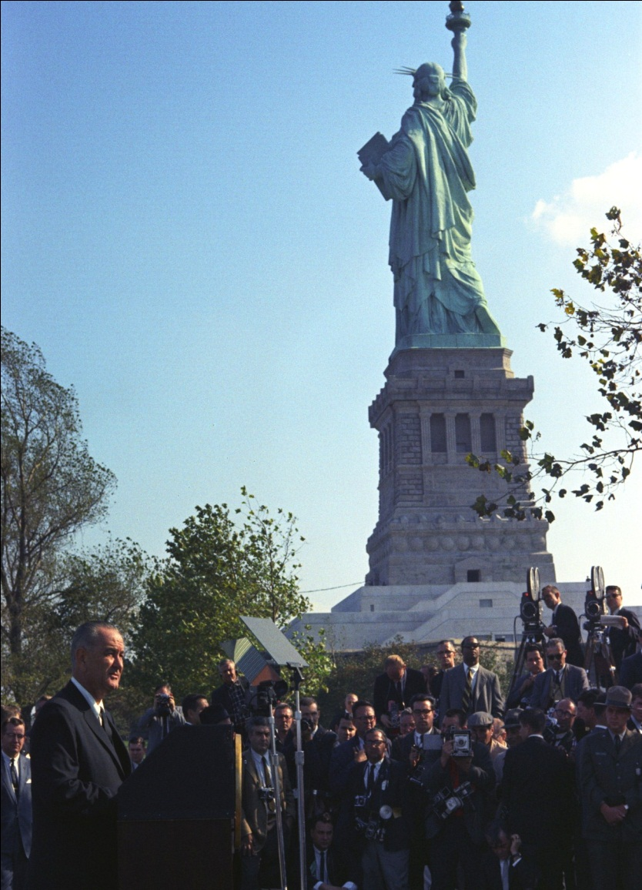
LBJ Signs Immigration and Nationality Act (1965)
Abolished Quotas
Limits immigration to about 1 million/year
Family reunification most important consideration

Slide 16
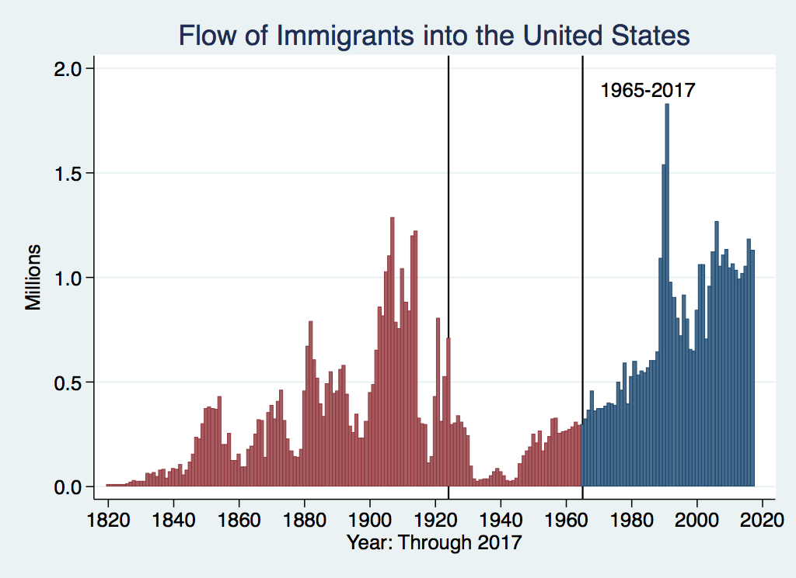
History of U.S. Immigration: 1965-Today
Source Country | 1965-2017
Mexico | 4,300,000
Philippines | 1,400,000
Korea | 760,000
Dominican Republic | 750,000
India | 740,000
Cuba | 700,000
Vietnam | 700,000
Canada | 650,000
https://www.libertyellisfoundation.org/immigration-timeline

Slide 17
NUMBER OF IMMIGRANTS BY TYPE OF ADMISSION: FISCAL YEAR 2022
Family-sponsored preferences | 165,642
Immediate relatives of U.S. citizens | 428,581
Employment-based preferences | 270,206
Diversity | 43,175
Refugees | 29,407
Asylees | 53,662
Other | 27,331
TOTAL | 1,018,004
{
594,223

Slide 18
H1B Applications
Quota Reached on First Day 2017

Slide 19
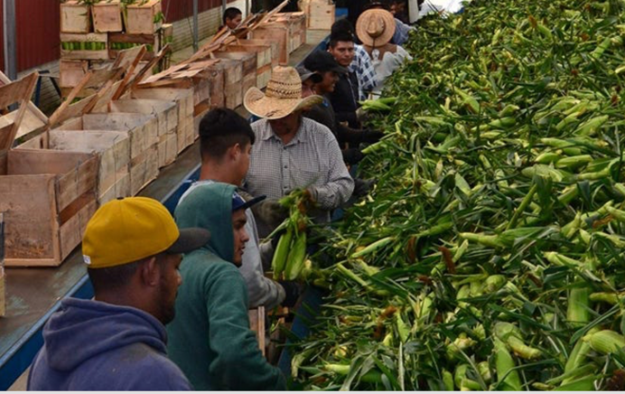
H2A Program

Slide 20
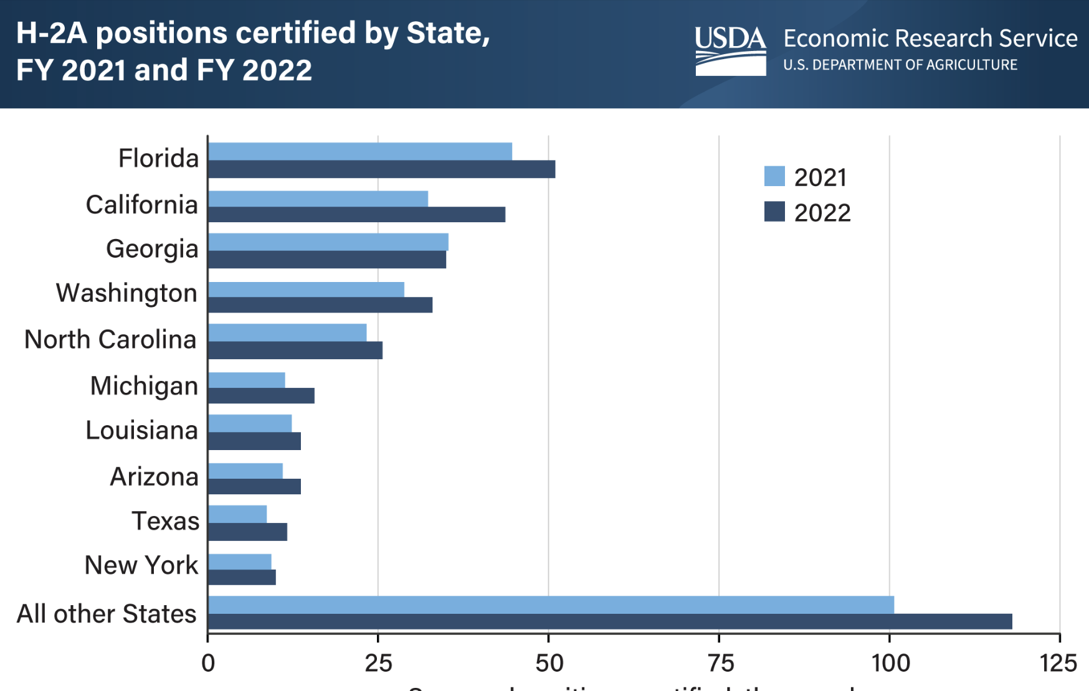
H2A Visas by State
Minneso 3,781
Total 377,000

Slide 21
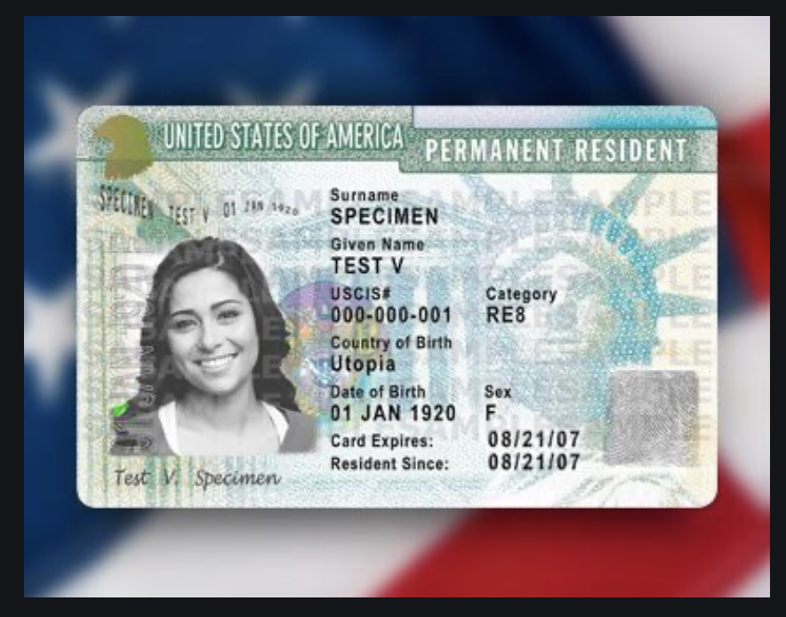
Immigration Reform and Control
Act of 1986
Grants amnesty to undocumented individuals in US since 1982
Must pay penalty and back taxes
Amnesty granted for being undocumented
Path to citizenship
Two million people took advantage, mostly Mexican
Illegal to knowingly hire undocumented workers
Green Card

Slide 22
Immigrant Share of US Workforce
2022 18.1 % immigrant share

Slide 23
Origin of Immigrants
Home | U.S. Share | MN Share
Europe | 9.1 % | 9.0 %
Asia | 39.3 % | 36.3 %
Africa | 9.4 % | 29.4 %
Oceana | 0.6 % | 0.6 %
N. America | 32.7 % | {24.8 %
S. America | 8.2 %
Unknown | 0.6 % | --
Total | 100.0 % | 100.0 %

Slide 24
The Migration Decision
Benefit of Migrating
Benefit of Staying
Cost of Migrating

Slide 25
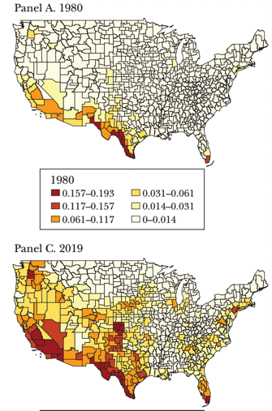
Share of Population Born in Latin America & Caribbean
1980
2019

Slide 26
Immigration to Minnesota
Immigrants tent to be of working age. More so that US Born.
Age | Foreign Born | U.S. Born
0-17 | 9.8 % | 21.7 %
16-64 | 80.5 % | 60.9 %
65 + | 9.7 % | 17.3 %

Slide 27
Immigration to Minnesota
County of Origin | Percent of Immigrants
Mexico | 12.0 %
Somalia | 7.3 %
India | 6.0 %
Ethiopia | 5.4 %
Laos | 5.2 %

Slide 28
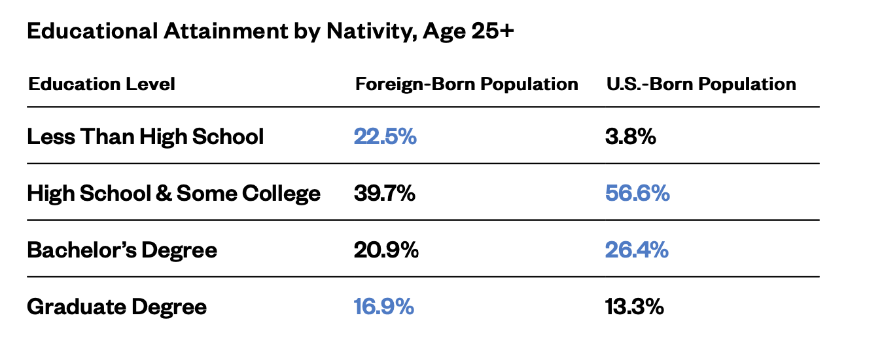
Immigration to Minnesota

Slide 29
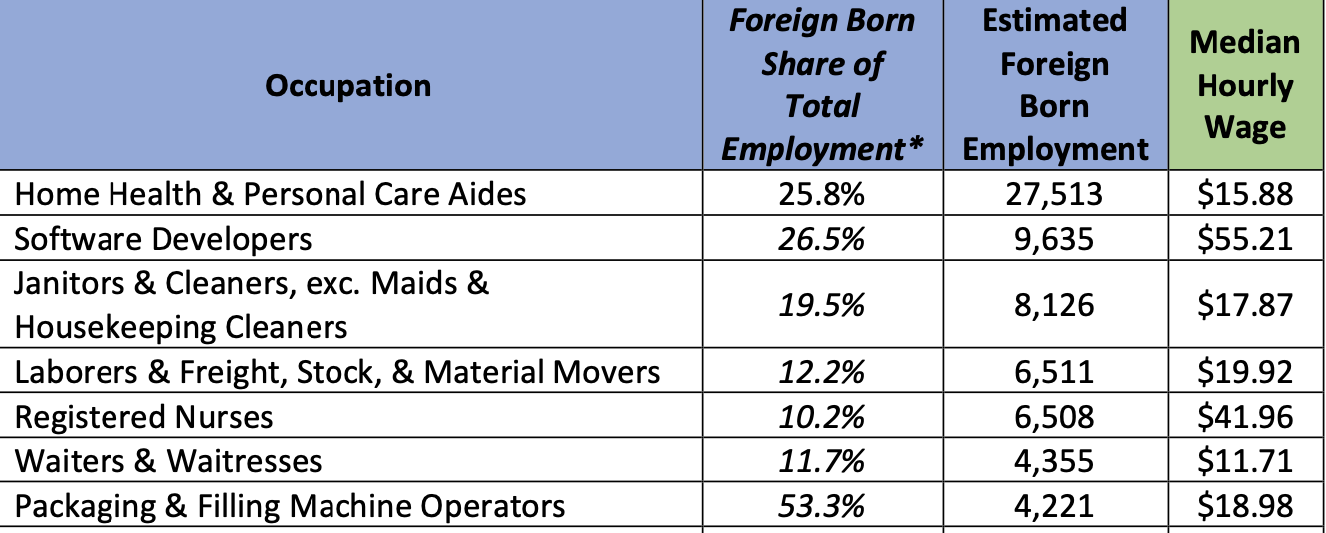
Immigration to Minnesota

Slide 30
Characteristics of Native and Latin Amer. Born Population (United States, Age 16 & up)
 | Native Born | Lat. Amer. Born
Labor Force | 130 Mil. | 13 Mil
< H.S. Educ | 5.8% | 37.1.%
Poor English | 1.9% | 77%
Employed | 59.2% | 64.9%
Unemployed | 3.0% | 3.5%
Med. Wk. Earn | $1,087 | $758
Poverty Rate | 13% | 17%

Slide 31
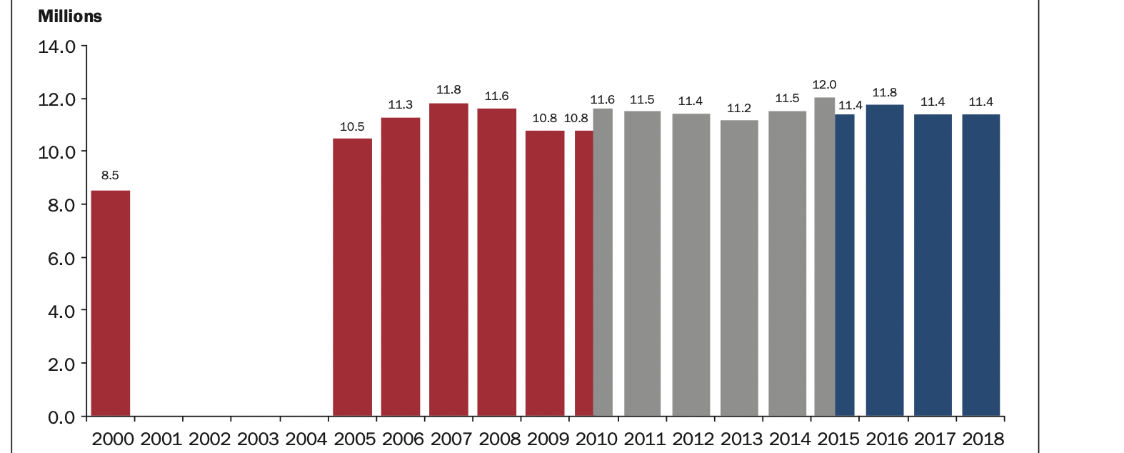
Number of Undocumented Immigrants in the United States
Minnesota 75,100

Slide 32
Impact of Mexican Immigration
Low-skill, low-wage jobs.
Competition for less skilled native-born
More GDP & lower prices, fill job vacancies
Helps upper income native-born, hurts lower
Little impact on federal budget but raises costs for state and local (schooling)

Slide 33
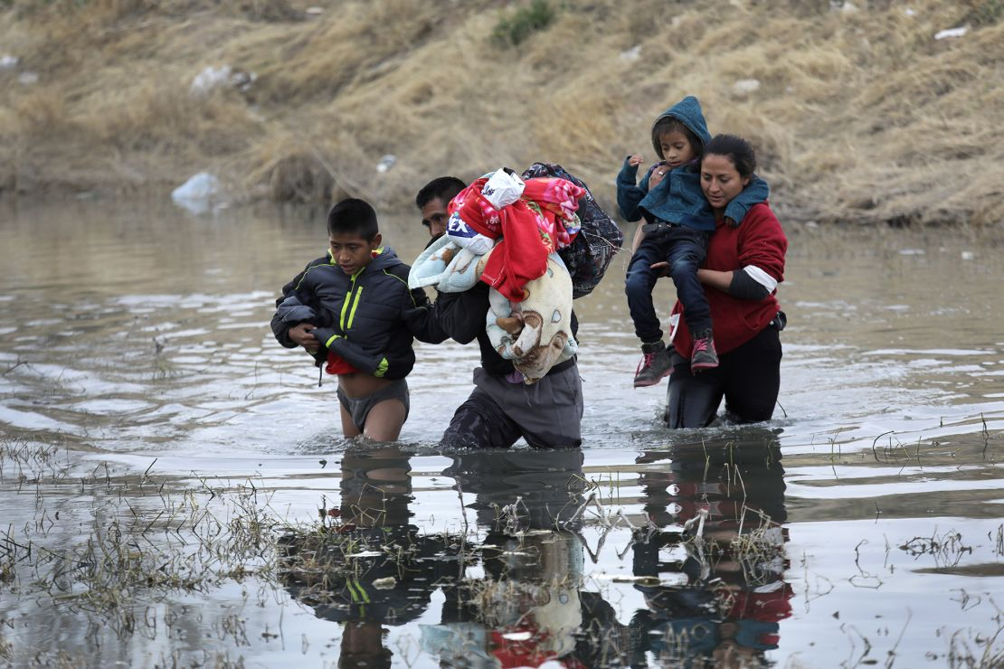
Recent Immigration Issues
DACA
The Northern Triangle
Unaccompanied Minors
Covid and Title 42
The Venezuelan Wave
Biden’s Executive Order

Slide 34
DACA (Deferred Action for
Childhood Arrivals)
Entered U.S. before age 16, now in U.S.
Entered before June 2007
Currently in school, high school grad or honorable discharge from military
No felony conviction or threat to security
Renewable every 2 years
Executive Order by Obama, Trump ended, Biden restored
4,140 in Minnesota

Slide 35
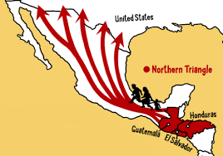
The Northern Triangle

Slide 36
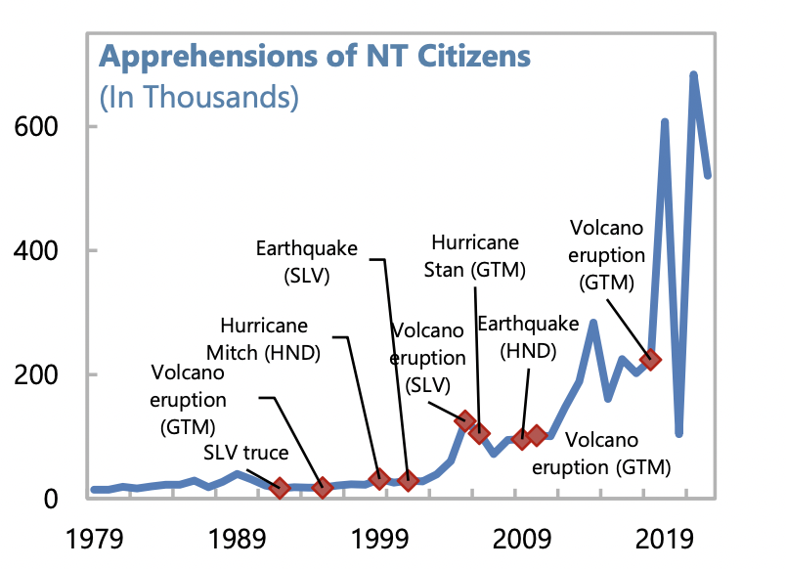
US Border Apprehensions from the Northern Triangle

Slide 37
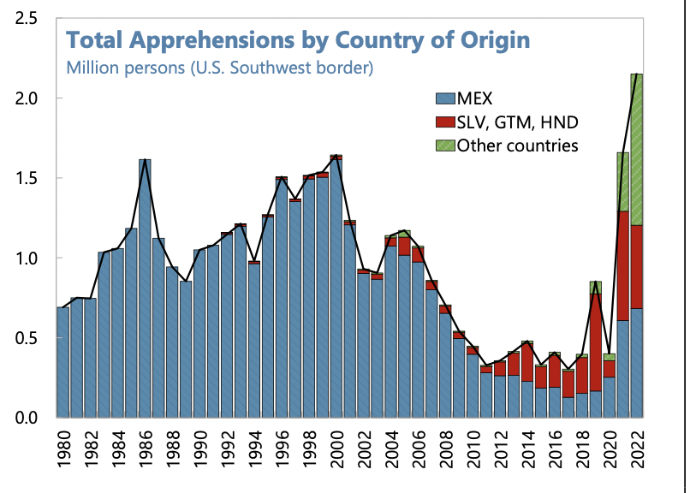
Northern Triangle Apprehensions
(Northern Triangle Countries in Red)

Slide 38
Asylees and Refugees
Refugees are usually outside the United States when they are screened for resettlement in US
Asylum seekers submit their applications while physically present in the United States or at a U.S. port of entry
Reason to grant – (US & UNHCR) unable to return because of persecution or a well-founded fear of persecution based on: race, religion, nationality, membership in a particular social group, or political opinion. (Not economic hardship!)
Minnesota 115,800 refugees

Slide 39
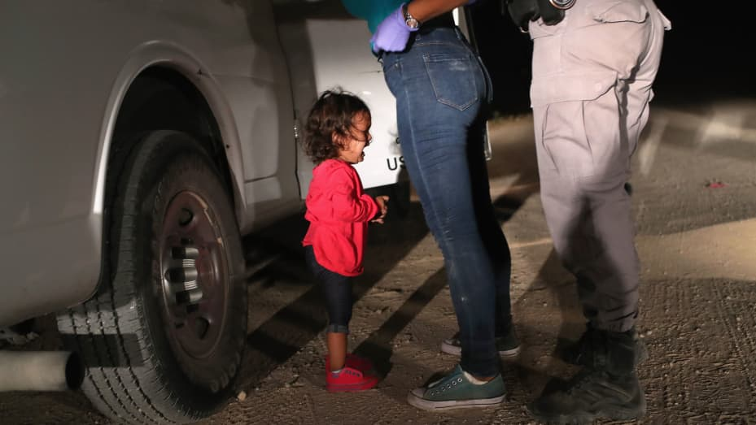
Separation of Children

Slide 40
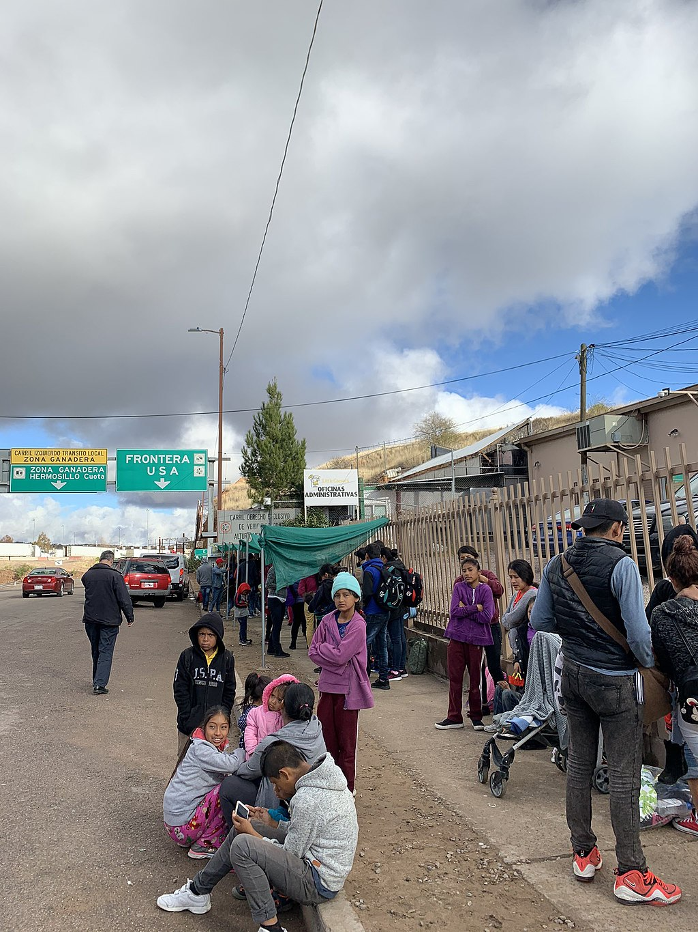
Remain in Mexico Policy - 2019
Applies to non-Mexicans asking for asylum
Must wait in Mexico while case being heard
Not applied to unaccompanied minors
Not eligible for asylum if passed through another nation on way.
Dangerous in Mexico
In the courts now, not in effect

Slide 41
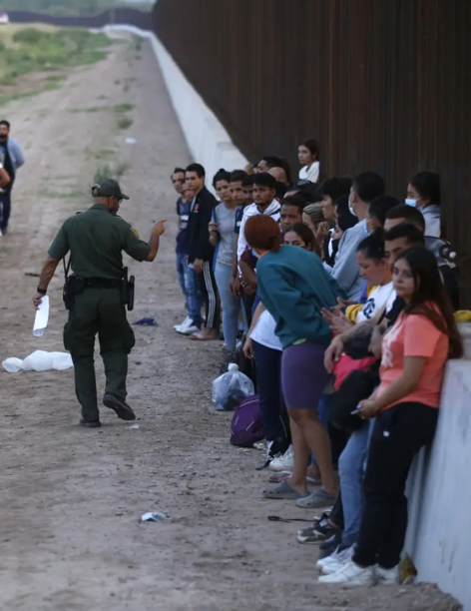
Covid and Title 42
Started in March 2020.
Used to limit Covid
Migrants who crossed into United States not allowed to ask for asylum
Returned to Mexico, not given a hearing
Ended May 2023

Slide 42
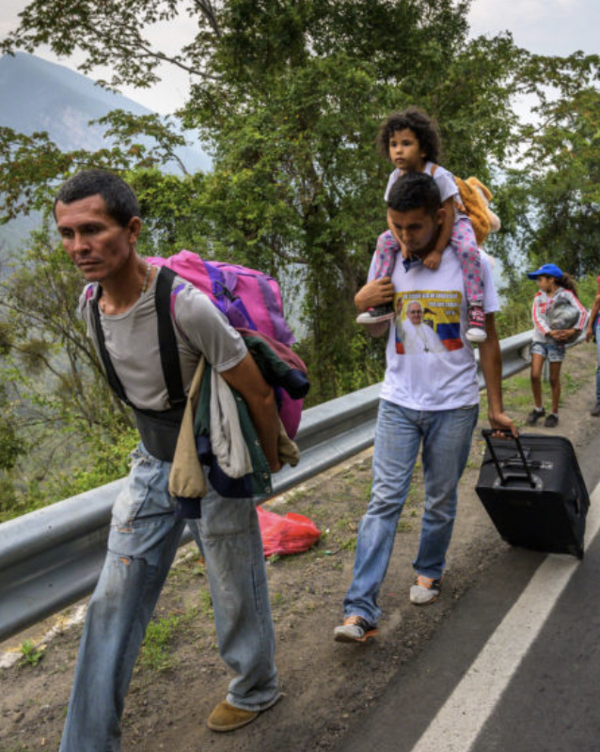
The Surge of Venezuelans
Almost 8 million Venezuelans have left
Caused by economic mismanagement, hyperinflation, unrest, violence
Largest national group arrested for entering US
Temporary Protected Status

Slide 43
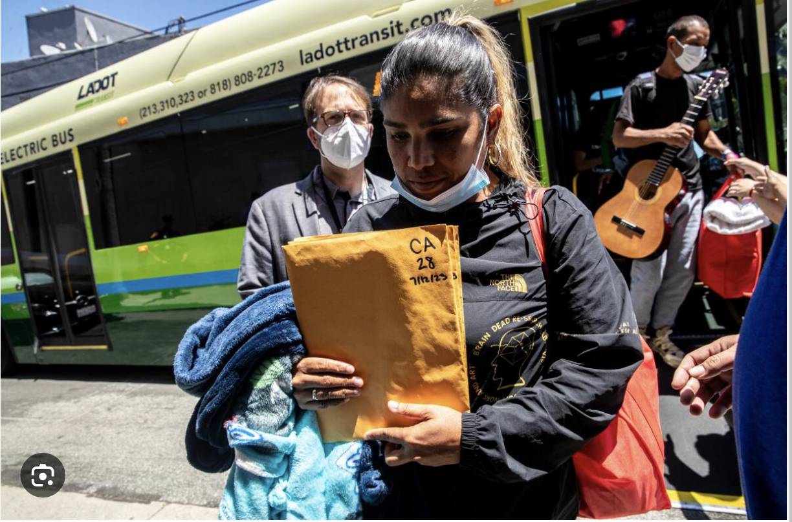
The Bussing of Migrants

Slide 44
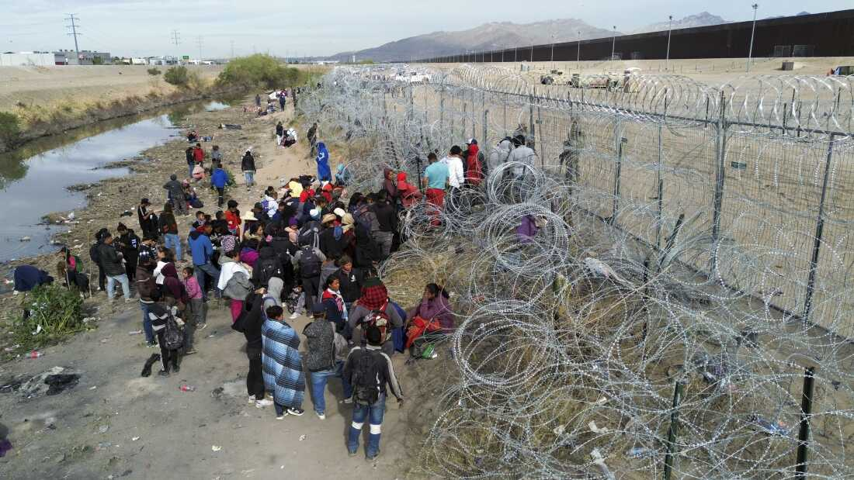
Biden’s Executive Order
Issued June 2024
Takes effect if unauthorized crossings exceed daily average of 2,500
December, 2023 average 8,000/day, April, 2024 fell to 4,300
3,200 per day in first week
Migrants who cross without authorization not eligible for asylum
Expedited removal
Unaccompanied children and
human trafficking victims exempted
Mexico won’t accept all, some released
Being challenged in the courts

Slide 45


Slide 46
Thank you!
Any Questions?
www.NEEDEcon.org
Robert Gitter
rjgitter@owu.edu
Contact NEED: info@NEEDEcon.org
Submit a testimonial: www.NEEDEcon.org/testimonials.php
Become a Friend of NEED: www.NEEDEcon.org/friend.php

